Slide 1
Content Hub One Features
Content Modelling
Content Authoring
Content Delivery

Slide 2


Content Hub One API Broad-level Categories
Content Management API
Preview and Delivery API
Developer
End-User

Slide 3

Content Hub One Developer Access Points
API
Content
SDK
Developer
CLI

Slide 4
Content Hub One API Types:
GraphQL
API
REST

Slide 5
Content Hub One SDK Support
.NET
SDK
JavaScript

Slide 6
Content Hub One API Types:
GraphQL | REST
Delivery API | Content Management API
Preview API | Media Upload API
 | Media Delivery API

Slide 7
Content Hub One Content Management API Endpoint Categories:
Content Types
Media Items
Content Items

Slide 8
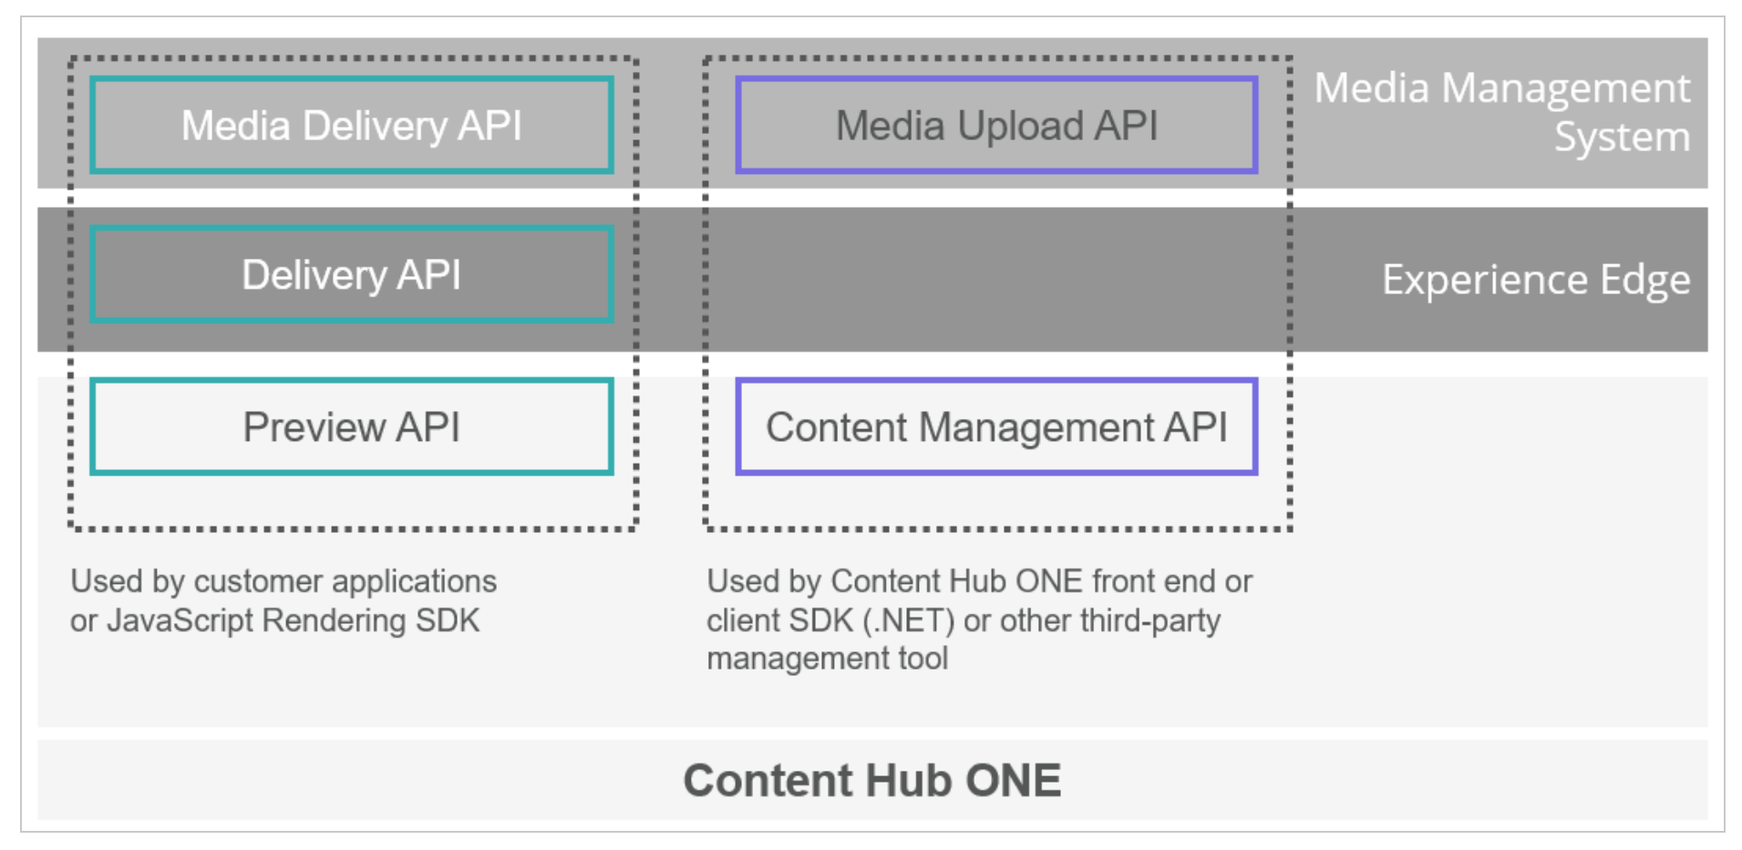
Content Hub One APIs:

Slide 9



Content Hub One Delivery:
D
E
L
I
V
E
R
Y
E
D
G
E
Content Hub ONE
Publish

Slide 10
Content Management API Swagger REST Endpoints:
Authorize
GET
PUT
DELETE
POST
ContentTypes
ApiKey
ContentItems
Media
Users

Slide 11
Content Hub One CLI Custom Plugin Development Process:
Create a Project
Create the plugin
Create command
Register the command
Content Hub One CLI SDK Inheritance:
BaseCommandHandler
BaseCommand
IPlugin
CommandHandler
Command
Plugin

Slide 12
Content Hub One in a nutshell:
Content Modeling
Content Authoring
Content Delivery
Model Content
Create Content
Link Media to Content
Deliver Content to Channel

Slide 13
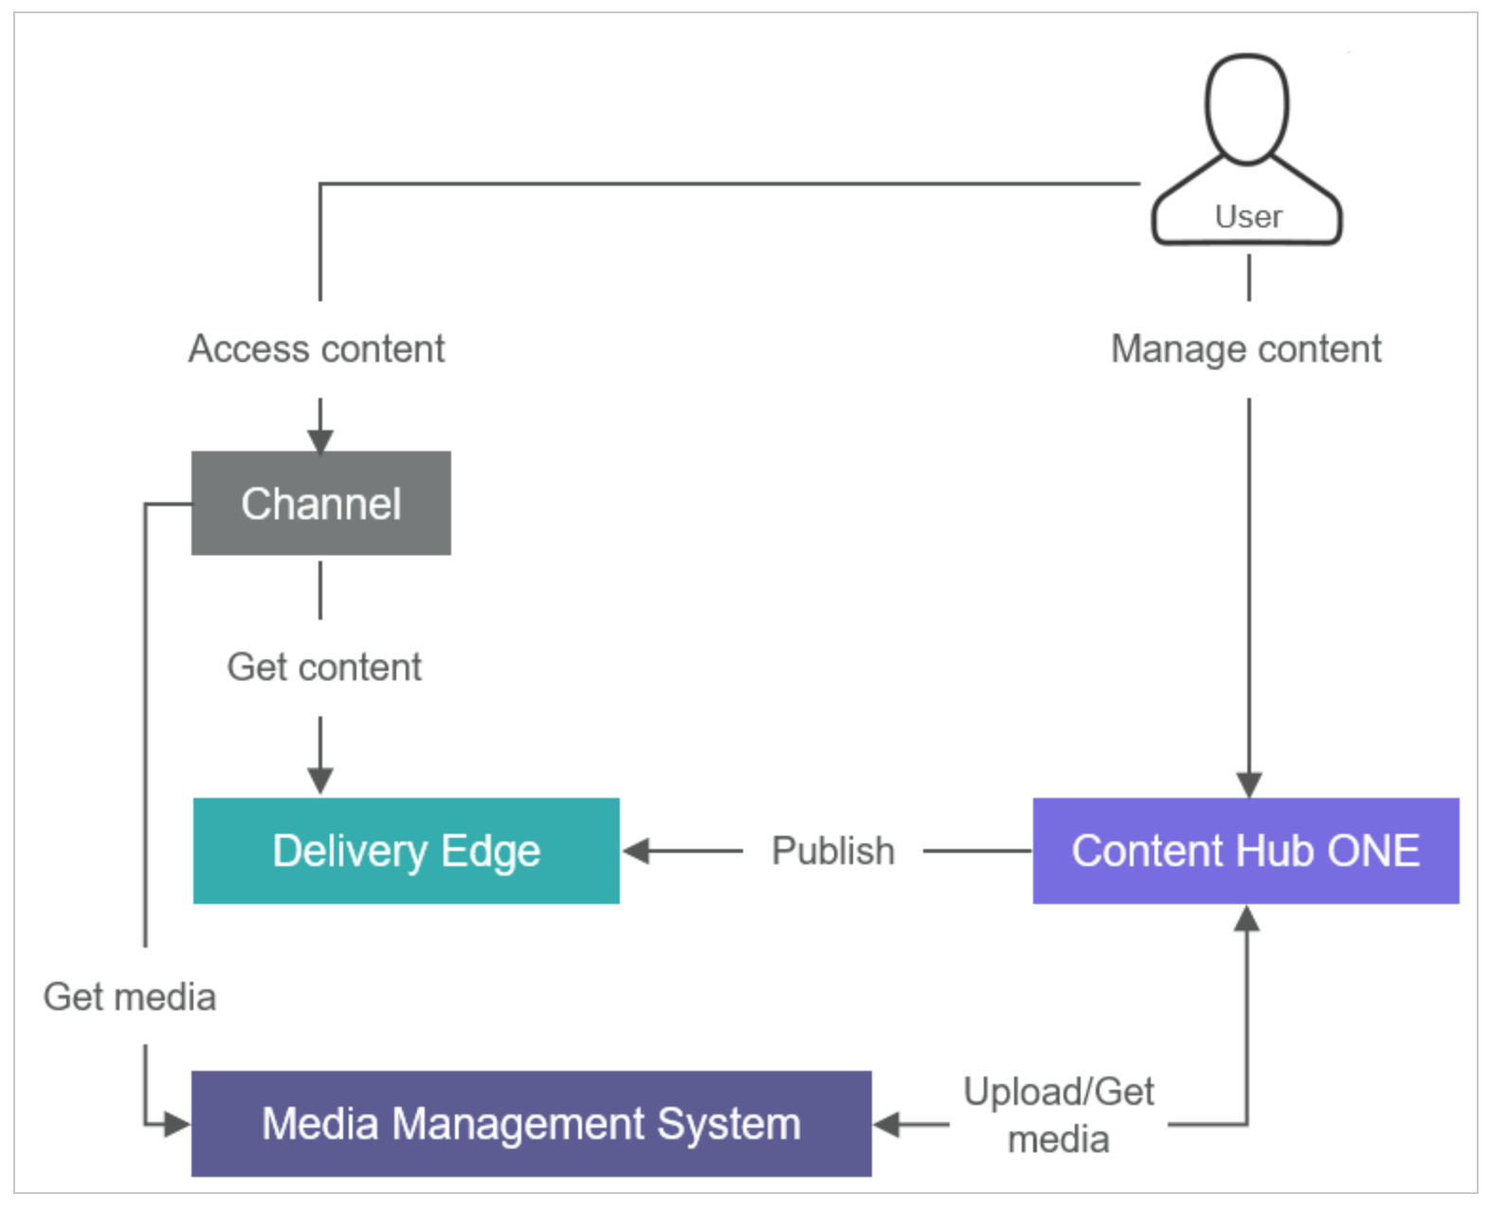
Content Hub One Architecture:

Slide 14
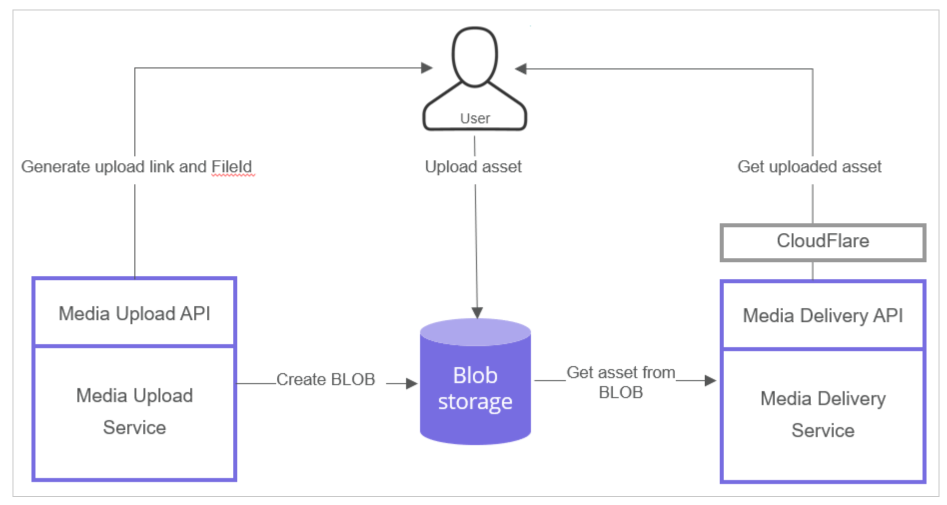
Content Hub One Media Management:

